Slide 1


Enhancing the Privacy and Utility of Synthetic Datasets with Generative Machine Learning
Midterm Presentation, 2 October 2024
Zehao Zhang
zehao.zhang@uzh.ch

Slide 2
Table of Contents
INTRODUCTION
RELATED WORK
METHODOLOGY
RESULTS
NEXT STEPS

Slide 3
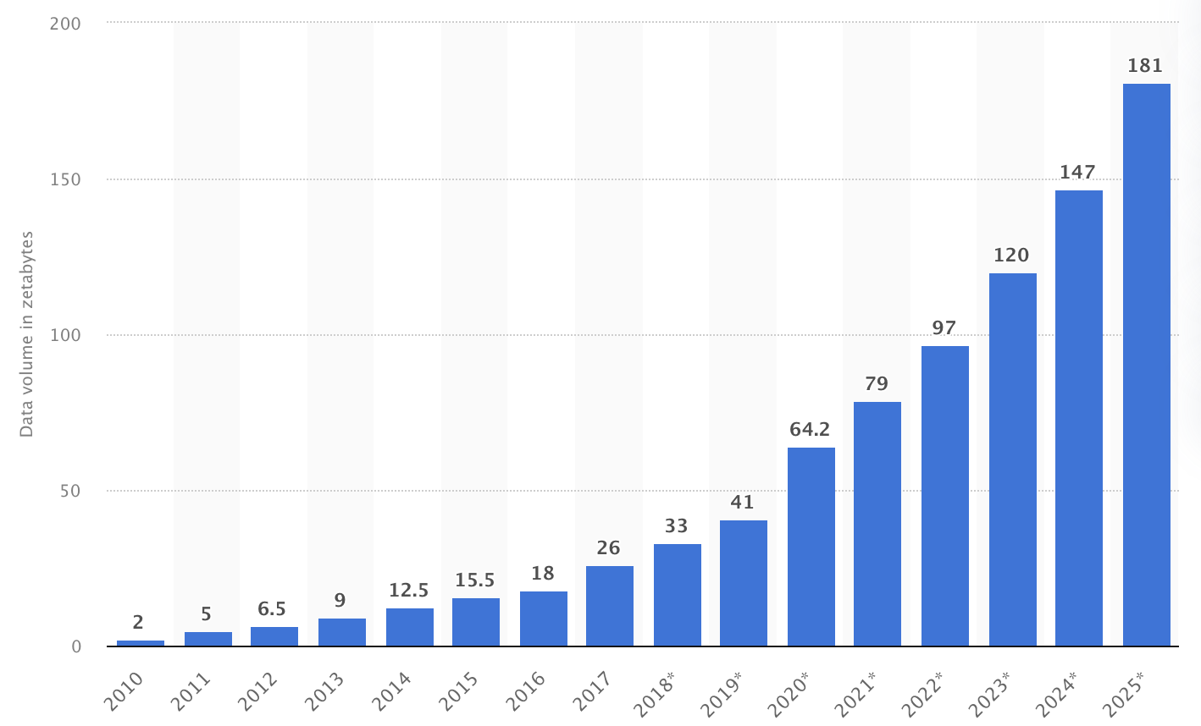
Introduction
Tabular data
Structured data format with columns and rows
Widely used in many data storage fields
Most common data in model training
Increasingly High Demand for Data
Limited access
Datasets with low utility
Sensitivity to Privacy in Data
Data carries much personal information
Sensitive information not allowed to be used
Volume of data/information created, captured, copied, and consumed worldwide from 2010 to 2020, with forecasts from 2021 to 2025
Notes:
Tabular data is a structured format, where information is organized into rows and columns, making it the primary type of data stored in databases and spreadsheets. Industries like healthcare and finance rely heavily on tabular data because it is well-suited for machine learning models, especially for tasks like classification, regression, and prediction. This data can include everything from patient records to financial transactions, customer information, and beyond.
However, the demand for data is at an all-time high, and organizations face increasing restrictions on how they can use and share this data due to privacy concerns, especially for small enterprises, they have quite limited access to useful data. Regulations like GDPR and HIPAA are designed to protect individuals' sensitive information, such as health records, financial details, or personal identifiers. While these regulations are crucial for protecting privacy, they also limit the availability of high-quality data for research and machine learning, forcing organizations to seek alternatives like synthetic data.

Slide 4
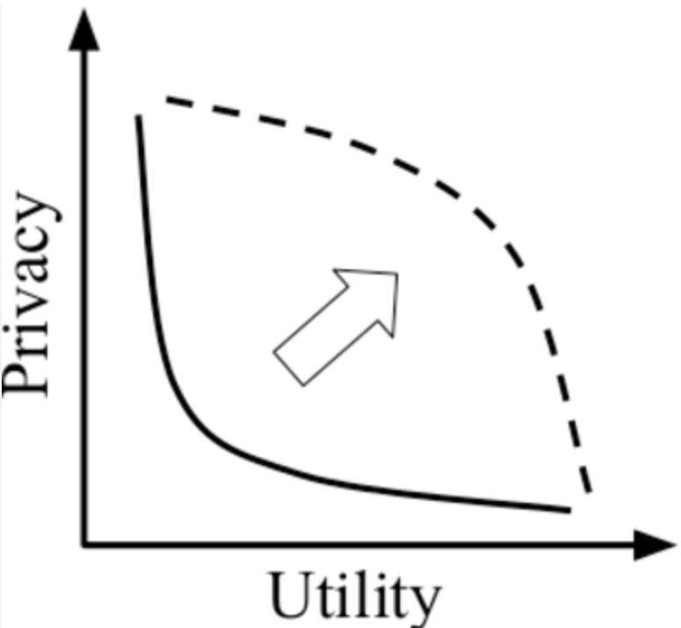
Introduction
Research Field:
Tabular Data Generation
Problem Statement:
Datasets not in high utility
High utility datasets might risk personal privacy
Goal:
Strike the optimal balance between utility and privacy
Notes:
The idea behind synthetic data is to create artificial datasets that resemble real data in terms of structure and statistical properties but without including any real personal information. This allows companies to continue building machine learning models without violating privacy laws. However, generating useful synthetic data is not easy. It’s a tradeoff between the utility and privacy
This is a complex challenge, and it’s the focus of my research. My goal is to develop methods that allow us to generate synthetic data that strikes the right balance between utility and privacy.

Slide 5
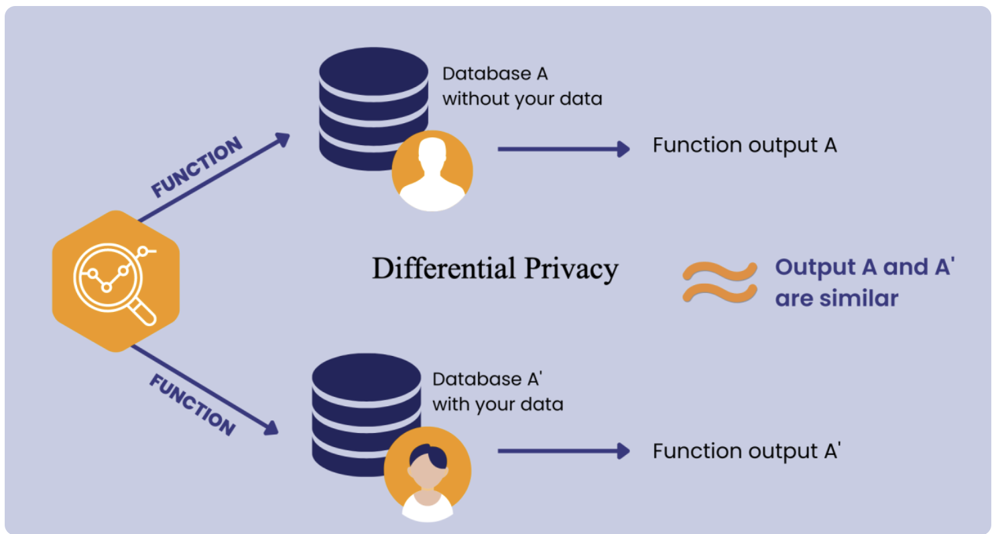
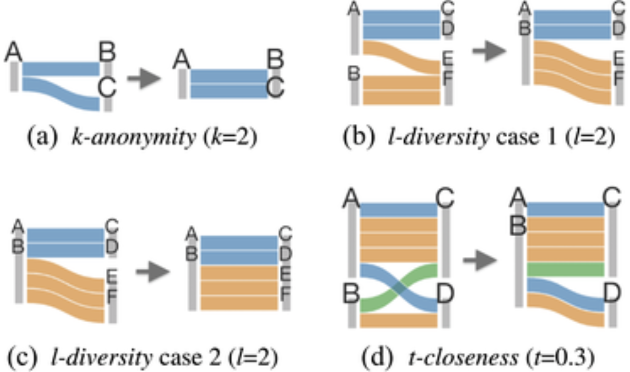
Related Work
Privacy Protection Methods
Differential Privacy
k-Anonymity
l-diversity
t-closeness
Notes:
Now I would like to walk you through some related work about this field. Considering privacy is an important part in my thesis, let’s first have a look at the privacy protection methods:
Differential Privacy is one of the most robust techniques, it adds noise to prevent individual identification and reverse engineering.
k-Anonymity is a traditional method, it hides individuals by grouping them with at least k others.
And the two extensions of k-anonymity are l-diversity and t-closeness
l-Diversity ensures diversity of sensitive attributes within those groups.
t-Closeness aligns the sensitive attribute distribution in groups with the whole dataset for extra protection.

Slide 6
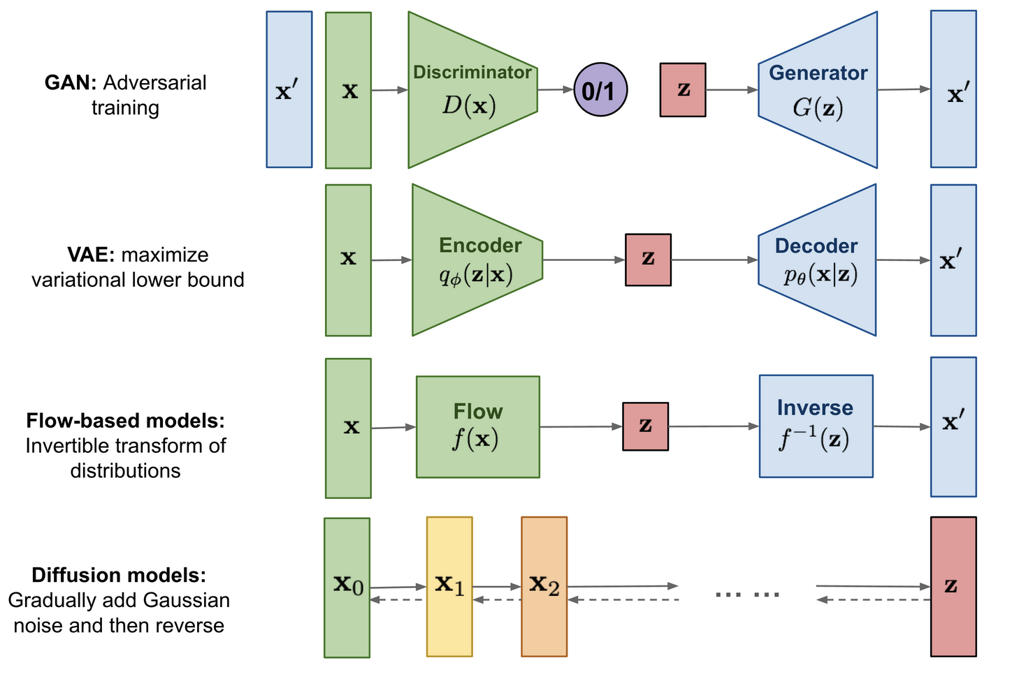
Related Work
Data Generation Methods
Generative Adversarial Network (GAN)
CTAB - GAN+ (Zilong Zhao)：
Strength:
Effective for mixed tabular data
DP-SGD to ensure privacy
Wasserstein loss with gradient penalty to ensure utility
Weakness
Computationally intensive
High Complexity
Tight privacy decreases utility
Notes:
Several methods have been proposed to generate synthetic tabular data, each with its own strengths and limitations. In my literature overview, I looked through some of them and play with some state-of-art representation of each model. One of the most well-known techniques is the Generative Adversarial Network (GAN), where two models—the generator and the discriminator—compete against each other. There are thousands of GANs, the state-of-art one target at tabular data generation is CTAB-GAN+ proposed by Zilong Zhao.
It incorporates an auxiliary component to better encode mixed data types, which is particularly useful for tabular data that contains both categorical and continuous variables. It also uses differential privacy during training, applying method DP-SGD (Differential Privacy – Stochastic Gradient Descent) to ensure privacy. In addition, CTAB-GAN+ uses a Wasserstein loss function with gradient penalty to stabilize the training process.
But the model requires long training times, especially with larger datasets. The model is complex due to the integration of various techniques, which can make it difficult to implement and tune effectively. As the privacy budget becomes tighter, the quality and utility of the synthetic data decrease.

Slide 7
Related Work
Data Generation Methods
Diffusion Model
TabDDPM (A, Kotelnikov)：
Strength:
Handling mixed and long-tail data
High data realism
Outperforms in maintain ML utility
Weakness
High computational demand
Complex model structure
Challenging hyperparameters tuning
Notes:
Another well-known generation model is diffusion model, which gradually denoise data, starting from random noise and working toward a realistic dataset. This method has shown exceptional results when it comes to mixed data types and long-tail distributions. One of the key strengths of TabDDPM is its ability to produce highly realistic data, which means high machine learning utility even better than GANs. However, this model is computationally intensive due to the complexity of the diffusion process. It also introduces challenges in hyperparameter tuning, making it more difficult to train compared to models like GANs.

Slide 8
Related Work
Data Generation Methods
Variational Autoencoders (VAE）
- Encode data into lower-dimensional latent space and reconstruct it back, learning from the latent distribution
Flow-based Models
- Use a series of invertible functions to compute both the data and its likelihood
Notes:
The other two generation methods are VAE and Flow-based models, both of them are quite good in handling complex data distribution, especially for continuous data, but they struggle with mixed data type which is common in tabular data, so I didn’t pay much attention to these two models in this field.

Slide 9
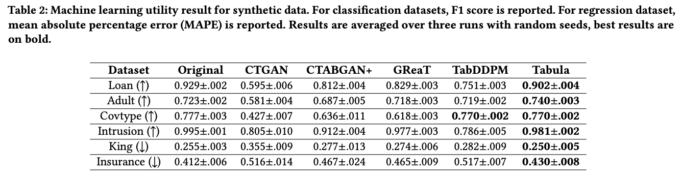
Related Work
Large Language Models (LLMs)
GReaT
Transformer-based decoder network architecture
Handling contextual knowledge of pretrained LLMs
Minimal preprocessing preserves more feature information
Computationally intensive and low scalability, sacrifice privacy
Tabula
Based on structure of GreaT
Token sequence compression
Middle Padding strategy
Outperforms the other current models
Notes:
Finally, we come to the large language models, these models, which have revolutionized natural language processing, are now being explored for their ability to generate structured data.
The first reliable model is GReaT, it adapts pretrained transformer models for tabular data generation by treating tabular data as sequences of tokens. It’s essentially transforming rows of data into sentences, and using the LLM’s ability to generate coherent text, Since LLMs are pre-trained on large datasets, they come with built-in knowledge of data relationships, which can be useful for generating realistic tabular data
GReaT requires minimal preprocessing rathe than extensive data cleaning and preparation.
However, it faces the same issue of computationally expensive due to the size of the underlying transformer models. Also it scarify the privacy while extracting details to improve utility.
Building on GReaT, the Tabula model introduces optimizations specifically for tabular data. It includes techniques like token sequence compression and middle padding to improve performance. Early experiments have shown that Tabula outperforms in machine learning utility compared to all models we mentioned before, making it a strong candidate as the baseline for my experiments

Slide 10
Methodology
Tabula as baseline
Utilize transfer learning
Together with some table-specific LLMs
More powerful privacy protection
Evaluation
Similarity between original data and generated data (statistics)
Machine learning utility
Measuring privacy
Notes:
For our model design, we consider that we should use the Tabula as a baseline and try to improve it in both utility and privacy sides. So far, we plan to use transfer learning and together with other table-specific LLMs to improve the utility of synthetic data generated by Tabula. But since it involves a bunch of training process, it will be computation intensive which we are constrained. Our focus in this thesis will be privacy enhancement. And also as I mentioned in the last slide, LLMs extract many details and scarify the privacy for utility, it will be an interesting way for us to enhance the privacy protection while maintain the high utility of the model.
And another important process for this research is about the evaluation of synthetic data with three key metrics.
Similarity between generated data and original data is crucial for understanding whether the synthetic data maintains the structural properties of the original dataset.
The goal of generating synthetic data is often to use it in machine learning tasks, so it’s important to assess how well machine learning models perform when trained on synthetic data. For regression tasks, I use the Mean Absolute Percentage Error (MAPE), and for classification tasks, I use accuracy and F1 scores.
Privacy is the central focus of my research. It’s not implemented so far, but we will try to use some methods like membership inference attack test as well as statistical similarity and overfitting check to measure the privacy of the synthetic data.

Slide 11
Methodology
Experiments – 1
Model M0 pre-trained in one dataset to get a pre-trained model M2
Use M0 and M2 to train another dataset with quite similar features (columns) and then generate two synthetic datasets
Evaluate all metrics on generated datasets
Hypothesis
Pre-trained model can have better performance
D2
M0
M1
GD1
D1 and D2 have the same feature
GD means generated data
D1
M2
D2
M3
GD2
Notes:
In Tabula paper, they made a conclusion that random initialized model will have a faster converges compared to a pre-trained model. Inspired by this, I’ve designed two key experiments. The goal of these experiments is to evaluate whether pre-trained models can improve the quality of synthetic data compared to the random initialized model (which is proposed in Tabula).
In Experiment 1, I use a model, M0, which is pre-trained on one dataset to create a pre-trained model, M2. I then use both M0 and M2 to train another dataset that has similar features, and from there, I generate two synthetic datasets. The idea is to compare the performance of these two models—M0, which starts from scratch, and M2, which benefits from pre-training. I hypothesize that the pre-trained model will perform better in terms of both utility and privacy.*

Slide 12
Methodology
Experiments – 2
Model M0 pre-trained in three tabular dataset (no fixed features) to get a new model M2
Use M0 and M1 to train another tabular dataset and then generate two synthetic datasets
Evaluate all metrics on generated datasets
Hypothesis
Pre-trained model can have better performance
M0
D4
M1
GD1
GD2
D1
M2
D2
M3
D3
M4
D4
M5
Notes:
In Experiment 2, I extend this approach by pre-training M0 on three different datasets to create a new model, M4. Once again, I compare the performance of M0 and M4 in generating synthetic data. The hypothesis here is that a model trained on multiple tabular datasets even without similar features should perform better while handling tabular data generation tasks.

Slide 13
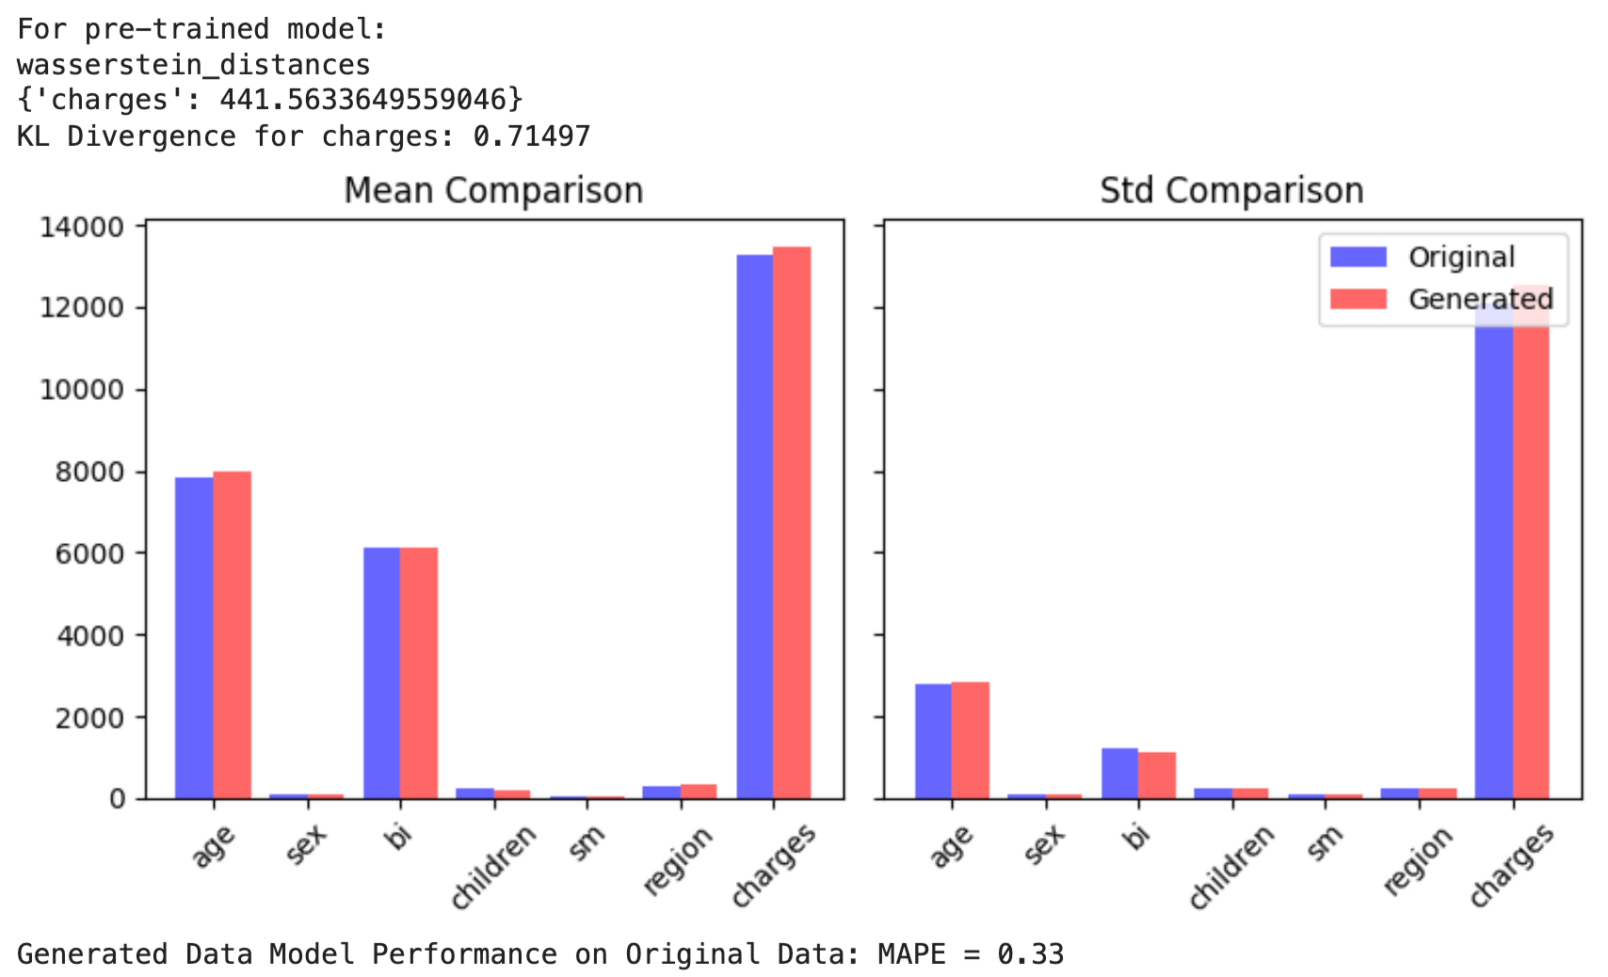

Results
Experiments – 1 (Insurance dataset)
M0
D2
M1
GD1
D1
M2
D2
M3
GD2
GD2 compared with original D2
GD1 compared with original D2
Notes:
In Experiment 1, which used an insurance dataset, I found that the pre-trained model, M2, outperformed the baseline model, M0, in several key areas. Specifically, M1 produced synthetic data that was more similiar to the original data in terms of its statistical properties like KL divergence. Additionally, machine learning models trained on the synthetic data generated by M2 performed better by comparing MAPE. I did the same in other datasets, it performs better in regression and classification tasks. This suggests that pre-training on a similar dataset can significantly improve the quality of the synthetic data, which is also very intuitive.

Slide 14
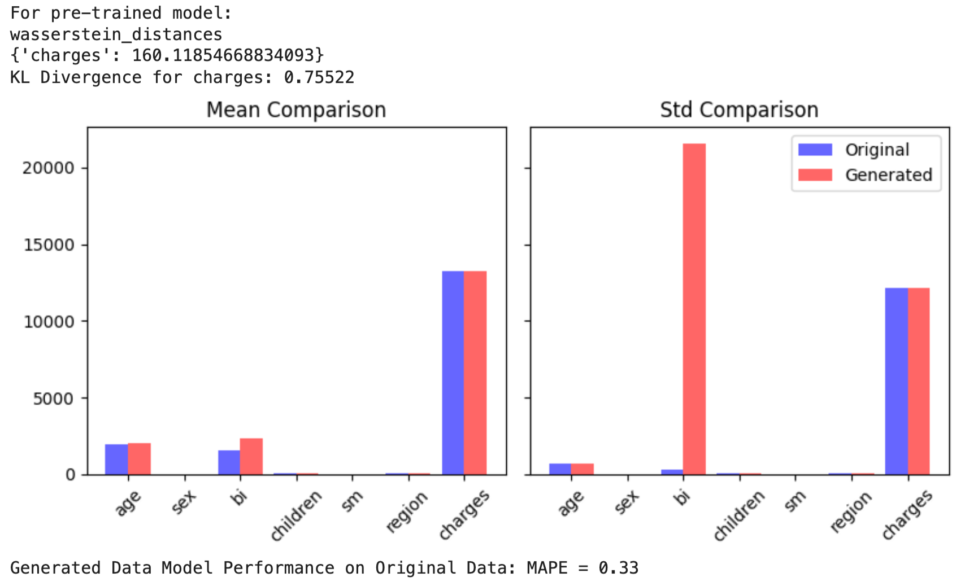
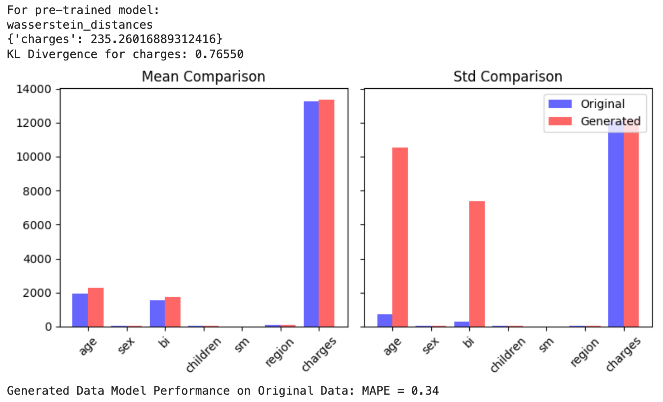
Results
Experiments – 2 (Insurance dataset)
M0
D4
M1
GD1
GD2
D1
M2
D2
M3
D3
M4
D4
M5
GD2 compared with original D2
GD1 compared with original D2
Notes:
In Experiment 2, I expected that the model pre-trained on multiple datasets (M4) would perform better even than model from experiment 1. However, the results show that there is no clear indication that M4 behaves better than the random initialized model M0. And you can also notice that some abnormal signs appear in the graph for standard deviation for both synthetic datasets in some attribute. I haven’t figured it out why it happens, it will also be a concern in my future research.

Slide 15
Results
Initial Conclusion
If the model is pre-trained on datasets with similar feature distribution, it can have better performance on synthetic data generation task in target datasets
Models pre-trained on multiple datasets with different feature distribution might not help a lot in synthetic data generation for tabular dataset
Notes:
Based on the experiments so far, I can draw a few initial conclusions. First, model pre-training on similar datasets significantly enhances the performance of synthetic data generation tasks in terms of data utility. The pre-trained model (M1) consistently produced better synthetic data than the model trained from scratch.
However, pre-training on multiple datasets doesn’t necessarily lead to better results. This suggests that the choice of pre-training data is critical, and training on a similar dataset may be more effective than using a broad, general dataset.

Slide 16
Next Steps
Improve Utility
More related literatures to capture good points to improve
More experiments to validate initial conclusions
Improve Privacy
Add privacy protection methods into LLMs-based models
Take good privacy protection methods from other models
Increase the privacy protection while maintain the utility
Notes:
In the future three months, there are two directions to go at the same time, I will do more literature review to capture those innovative methods to integrate with the current model to improve the utility of synthetic data. Also more experiments are expected to validate initial conclusions.
But considering it’s a process involving model pre-training, and we are limited by computation resources. So, the focus in the future three months will lie on the privacy protection of the synthetic data. For now, my initial plan is to take the DP-SGD which occurs in CTABGAN+ into the training process. I will try to evaluate different kinds of privacy protection methods into the baseline model and compare the results to reach an optimal tradeoff between utility and privacy.

Slide 17
Thank You for Your Attention!
Q & A

